Slide 1
Project Title
Personalized medicine Redefining Cancer Treatment

Slide 2
CONTENT
A. Relevance of topic
B.A Description of the Project
C. Objectives of the Study
D. Existing System and Proposed System
E. Input/ Output and Modules identified
F.System Design or Algorithms to be used
G.Datasets

Slide 3
Relevance of topic
The interpretation of genetic mutations is a very time-consuming task since it is being done manually. Accurate prediction of survival in patients with cancer remains a challenge due to the ever-increasing heterogeneity and complexity of cancer, treatment options and patient populations.
Currently this interpretation of genetic mutations is being done manually. This is a very time-consuming task where a clinical pathologist has to manually review and classify every single genetic mutation based on evidence from text-based clinical literature.
The project aims at developing a Machine Learning algorithm that uses expert-annotated knowledge basewhere world-class researchers and oncologists have manually annotated thousands of mutations as a baseline, to automatically classify genetic variations.

Slide 4

Once sequenced, a cancer tumor can have thousands of genetic mutations. But the challenge is distinguishing the mutations that contribute to tumor growth (drivers) from the neutral mutations (passengers).
There are nine different classes a genetic mutation can be classified on. This is not a trivial task since interpreting clinical evidence is very challenging even for human specialists. Therefore, modeling the clinical evidence (text) will be critical for the success . Both, training and test, data sets are provided via two different files. One (training/test_variants) provides the information about the genetic mutations, whereas the other (training/test_text) provides the clinical evidence (text) that our human experts used to classify the genetic mutations. Both are linked via the ID field.
Therefore the genetic mutation (row) with ID=15 in the file training_variants, was classified using the clinical evidence (text) from the row with ID=15 in the file training_text’
A Description of the Project

Slide 5
To automatically classify genetic variations.
To distinguishing the mutations that contribute to tumor growth (drivers) from the neutral mutations (passengers).
To reduce the number of treatments patients may try by identifying more targeted treatments earlier.
Objectives of the Study

Slide 6
Genetic testing is one of the innovative precision medicine technique and the way diseases like Cancer are treated.
A biopsy will be taken of your tumor.
Cancer cells will be isolated and extracted from the biopsy, then their DNA will be sequenced in the lab.
Existing System

Slide 7
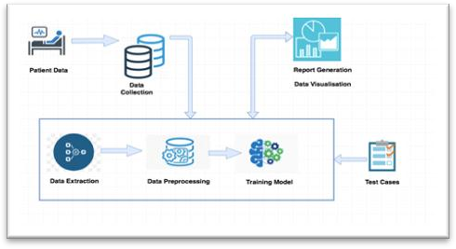
The project aims at developing a Machine Learning algorithm that uses expert-annotated knowledge base where world-class researchers and oncologists have manually annotated thousands of mutations as a baseline, to automatically classify genetic variations. The Various Machine Learning Model used is as follows:
Naïve Bayes
K-Nearest Neighbors
Logistic Regression
Linear Support Vector Machine
Random Forest Classifier
Stacking Model
Proposed System

Slide 8
Modules
1 LOADING AND PREPROCESSING OF DATA.
2 VISUALIZING DATA AND FIND CORRELATION AMONG FEATURES AND TARGET LABELS . . . . . . . . . . .
3 USE CLASSIFICATION TECHNIQUES AND FIND THEIR
ACCURACY
4 CONCLUDING THE BEST MODEL

Slide 9
The Various Machine Learning Model used is as follows:
Naïve Bayes
K-Nearest Neighbors
Logistic Regression
Linear Support Vector Machine
Random Forest Classifier
System Design or Algorithms to be used

Slide 10
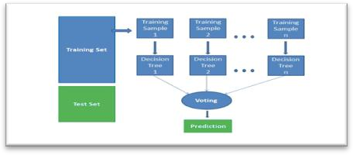
Datasets
Dataset has 9 different classes that we have to predict. Both training and test, datasets are provided into two different files. One (training/test_variants) provides information about the genetic mutation, whereas other (training/test_text) provides the clinical evidence(text) that human experts used to classify the genetic mutations..The collected our dataset from the Kaggle competition and Memorial Sloan Kettering Cancer Center (MSKCC). The dataset has three parameters: genes, variations and clinical text. In the training set, 9 classes of mutations are given. Our goal was to use these three provided variables to predict mutation classes. The training set has 3321 data entries which are about four times as much as the test set. A similar distribution can also be seen with the types of variations. However, there were more types of genes in the test set compare with the number of types in the training set.

Slide 11

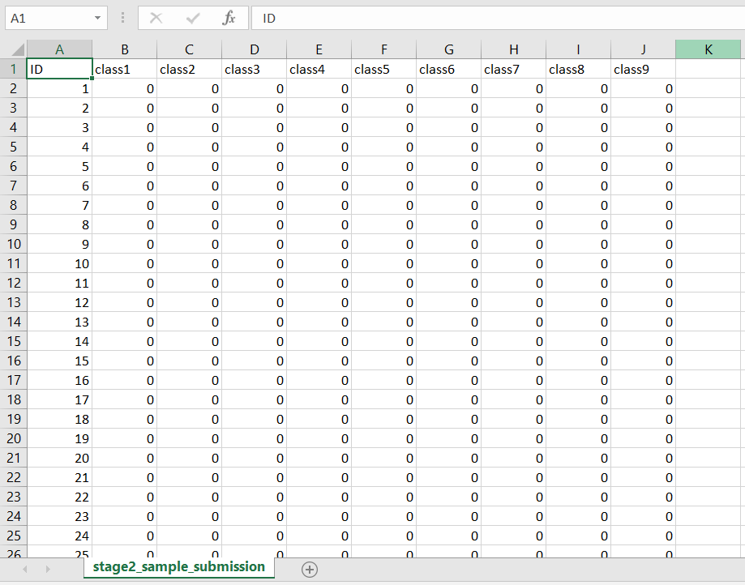

Slide 12
THANKS

